Slide 1
Module 4.5
Introduction to Browser Isolation

Slide 2
Web browser: an analogy
Operating system
Web browser
Subject: Processes
Has User ID (UID, SID)
Discretionary access control
Objects
File
Network
…
Vulnerabilities
Untrusted programs
Buffer overflow
…
Subject: web content (JavaScript)
Has “Origin”
Mandatory access control
Objects
Document object model
Frames
Cookies / localStorage
Vulnerabilities
Cross-site scripting
Implementation bugs
…
The web browser enforces its own internal policy. If the browser implementation is corrupted, this mechanism becomes unreliable.

Slide 3
Components of security policy
Frame-Frame relationships
canScript(A,B)
Can Frame A execute a script that manipulates arbitrary/nontrivial DOM elements of Frame B?
canNavigate(A,B)
Can Frame A change the origin of content for Frame B?
Frame-principal relationships
readCookie(A,S), writeCookie(A,S)
Can Frame A read/write cookies from site S?

Slide 4
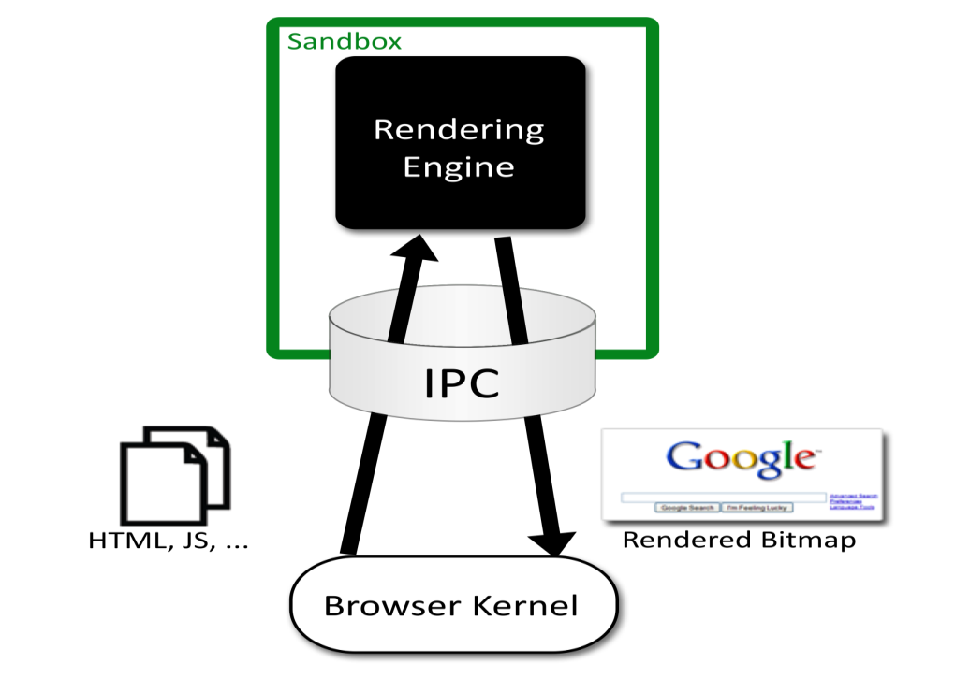

Chromium Security Architecture
Browser ("kernel")
Full privileges (file system, networking)
Rendering engine
Up to 20 processes
Sandboxed
One process per plugin
Full privileges of browser

Slide 5
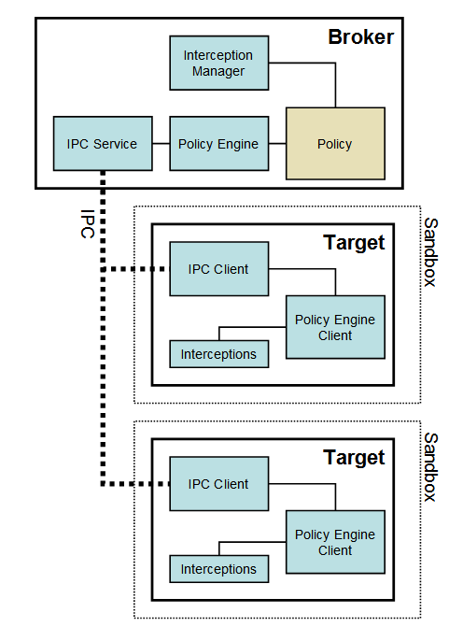
Chromium
Communicating sandboxed components
See: http://dev.chromium.org/developers/design-documents/sandbox/

Slide 6
Design Decisions
Compatibility
Sites rely on the existing browser security policy
Browser is only as useful as the sites it can render
Rules out more “clean slate” approaches
Black Box
Only renderer may parse HTML, JavaScript, etc.
Kernel enforces coarse-grained security policy
Renderer to enforces finer-grained policy decisions
Minimize User Decisions

Slide 7
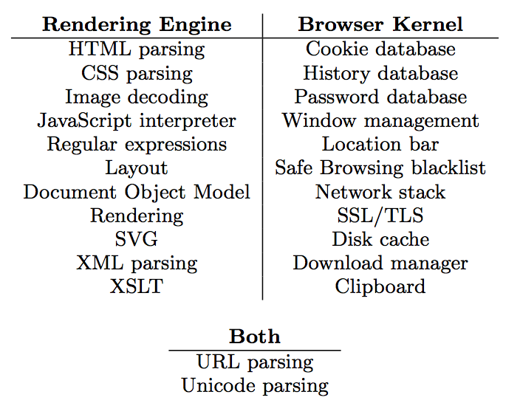
Task Allocation

Slide 8
Leverage OS Isolation
Sandbox based on four OS mechanisms
A restricted token
The Windows job object
The Windows desktop object
Windows Vista only: integrity levels
Specifically, the rendering engine
adjusts security token by converting SIDS to DENY_ONLY, adding restricted SID, and calling AdjustTokenPrivileges
runs in a Windows Job Object, restricting ability to create new processes, read or write clipboard, ..
runs on a separate desktop, mitigating lax security checking of some Windows APIs
See: http://dev.chromium.org/developers/design-documents/sandbox/

Slide 9
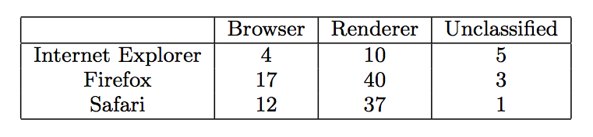
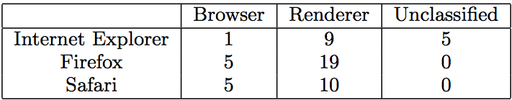
Evaluation: CVE count
Total CVEs:
Arbitrary code execution vulnerabilities:

Slide 10
Summary
Security principles
Isolation
Principle of Least Privilege
Qmail example
Access Control Concepts
Matrix, ACL, Capabilities
OS Mechanisms
Unix
File system, Setuid
Windows
File system, Tokens, EFS
Browser security architecture
Isolation and least privilege example

Slide 11
Lecture 4: Module-wise Summary
Total 5 Modules on Secure System Architecture and Access Control
Module 4.1: Secure Architecture Principles: Isolation and Least Privilege
Module 4.2: Access Control Concepts
Module 4.3: Unix and Windows Access Control Summary
Module 4.4: Other issues in Access Control
Module 4.5: Introduction to Browser Isolation

